Slide 1
Pascal Programming Language
Group-6
Romit zunjarrao
Rohan naik
Riya patel
Murad Mizanur Rahman

Slide 2
History of Pascal
Pascal is an imperative and procedural programming language, designed by Niklaus Wirth.
It was intended to encourage good programming practices using structured programming and data structuring.
It is named in honor of the French mathematician, philosopher and physicist Blaise Pascal.
Pascal was developed on the pattern of the ALGOL 60 language. Wirth was involved in the process to improve the language as part of the ALGOL X efforts and proposed a version known as ALGOL W.
This was not accepted, and the ALGOL X process bogged down. In 1968, Wirth decided to abandon the ALGOL X process and further improve ALGOL W, releasing this as Pascal in 1970.

Slide 3
Current work of Pascal
it led to the development of Object Pascal at Borland for their Delphi product.
Delphi is very much still in active use under the name embarcadero Delphi. It allows for modern cross platform development in Object Pascal.
if you are developing a product with a graphical user interface for release on multiple platforms, there really aren’t a lot of good options. Especially if you have limited resources and can’t run a separate team for each platform.
Embarcadero Delphi seems like a perfectly good toolset for that purpose.

Slide 4
Some of the Implementation’s of Pascal
Skype
Total Commander
TeX
Macromedia Captivate
Apple Lisa
Various PC Games
Embedded Systems

Slide 5
Features of Pascal
Pascal is a strongly typed language.
It offers extensive error checking.
It offers several data types like arrays, records, files and sets.
It offers a variety of programming structures.
It supports structured programming through functions and procedures.
It supports object oriented programming.

Slide 6
Data Types in Pascal
String
Holds Text eg. 'New York', 'Evan‘
Integer
Holds whole numbers eg 3, 6, 1024
Range : -32,768 to 32,767
LongInt : -2,147,483,648 to 2,147,487,647
ShortInt : -128 to 128
Real
Holds Decimal Numbers eg 3.14, 503.2
Range : 2.9 x 10 E-39 to 1.7 x 10 E+38
Boolean
Holds True or False
Character
Holds a single character eg. 'A', 'E'

Slide 7
Pascal Program Structure
A Pascal program basically consists of the following parts −
Program name
Uses command
Type declarations
Constant declarations
Variables declarations
Functions declarations
Procedures declarations
Main program block
Statements and Expressions within each block
Comments

Slide 8
program {name of the program}
uses {comma delimited names of libraries you use}
const {global constant declaration block}
var {global variable declaration block}
function {function declarations, if any}
{ local variables }
begin
...
end;
procedure { procedure declarations, if any}
{ local variables }
begin
...
end;
begin { main program block starts}
...
end. { the end of main program block }

Slide 9
Pointer’s

Slide 10
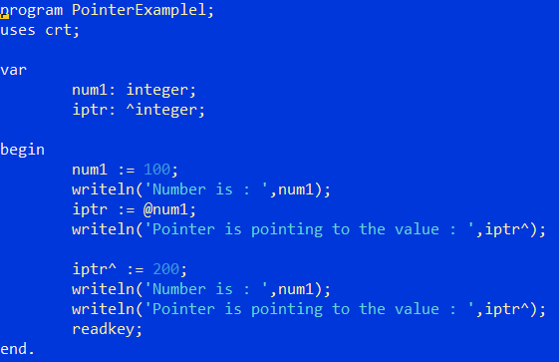
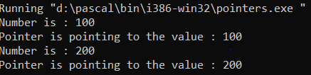
Output

Slide 11
Data Structure

Slide 12
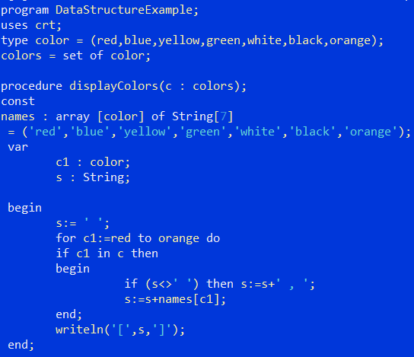

Output

Slide 13
Reference’s
Compiler Link
https://www.freepascal.org/
https://www.tutorialspoint.com/pascal/pascal_overview.htmL
https://cs.nyu.edu/courses/fall99/A22.0002-003/variables.html
https://www.tiobe.com/tiobe-index/programming-languages-definition/
https://www.pascal-programming.info/lesson1.php

Slide 14


